Slide 1
Medication Plan Monitoring System
Mobile Health & Sports
Final Presentation
Projectteam:
Endalkachew Asnake
Christoph Kieslich
Manuel Lindorfer
Bernhard Stemmer

Slide 2
Motivation

Slide 3




Big Picture
take medicine!
Patient
Server + Database
Doctor
register
Patient
Medical Plan
create plan
push plan

Slide 4
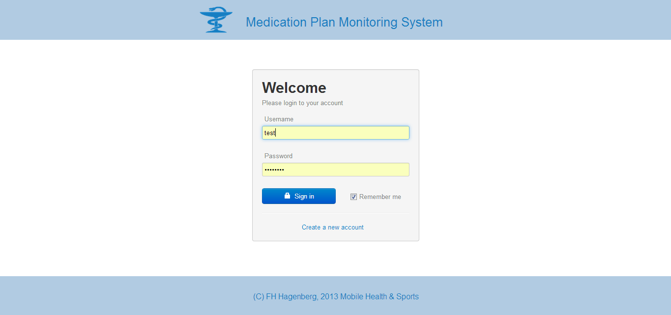
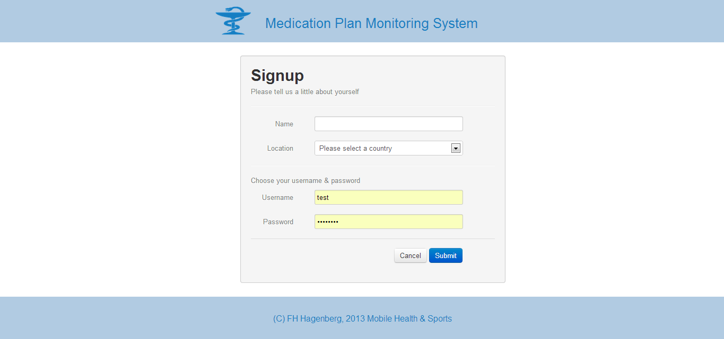
Website – Login/Sign in

Slide 5
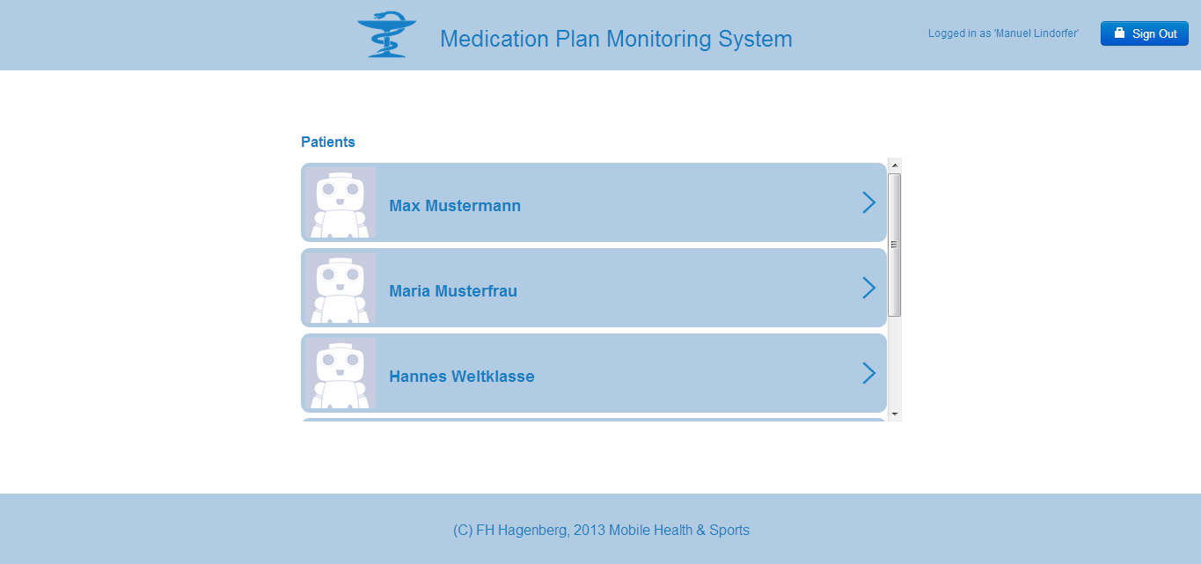
Website – Home Screen

Slide 6
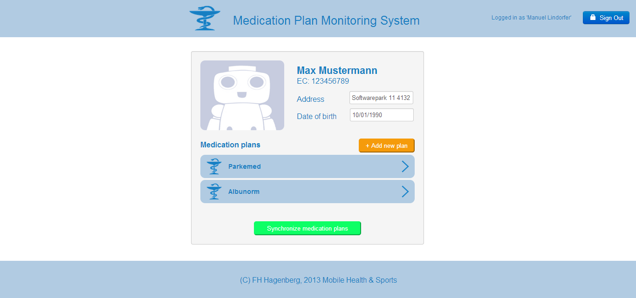
Website – Patient Detail

Slide 7
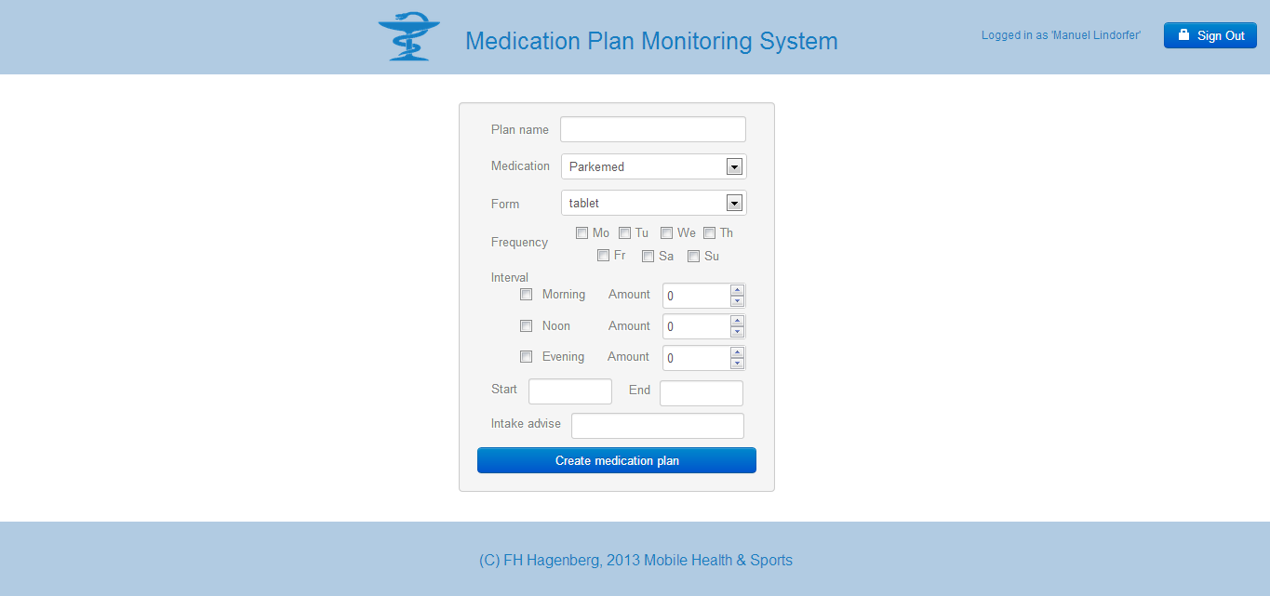
Website – create new plan

Slide 8
Website – Patient Detail

Slide 9
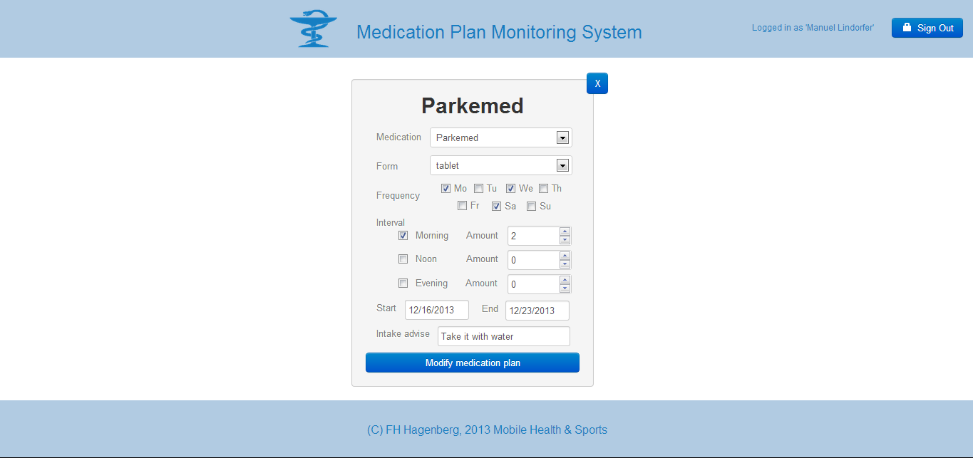
Website – edit plan

Slide 10
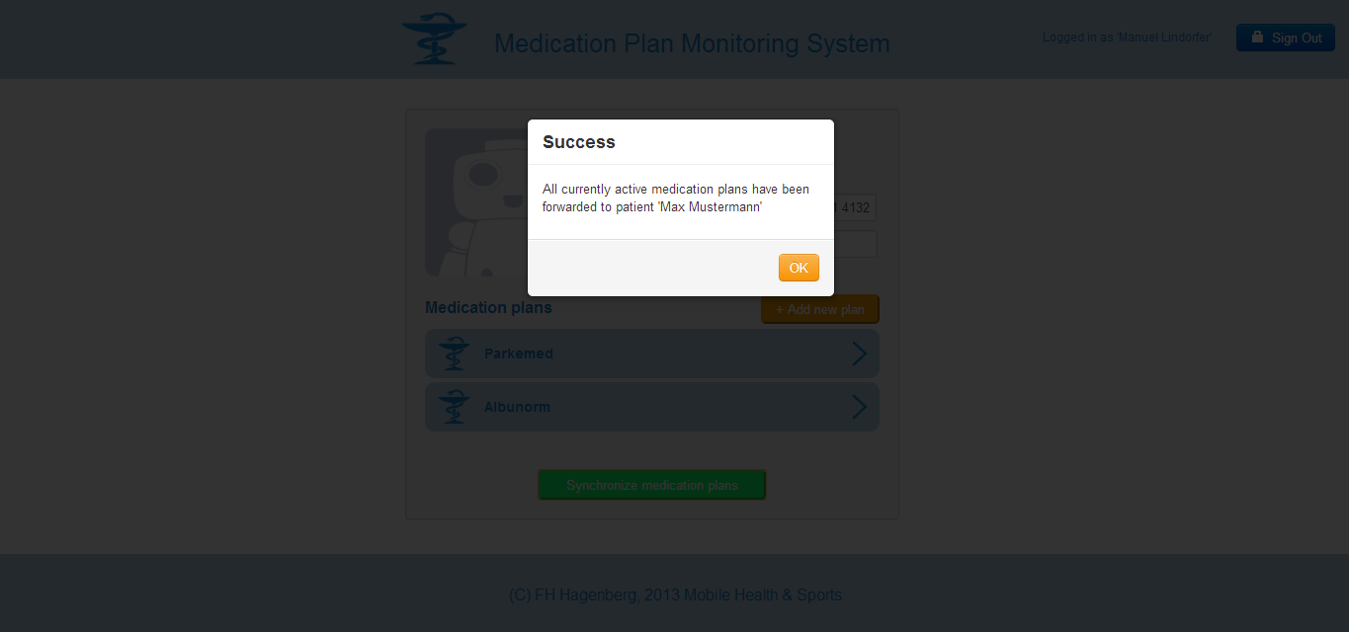
Website – Patient Detail

Slide 11
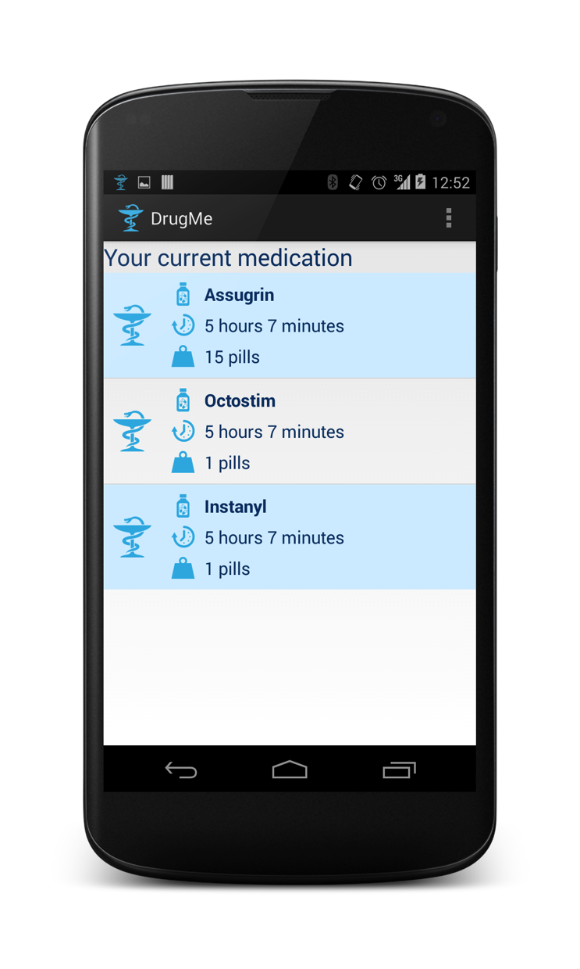
App – Startscreen

Slide 12
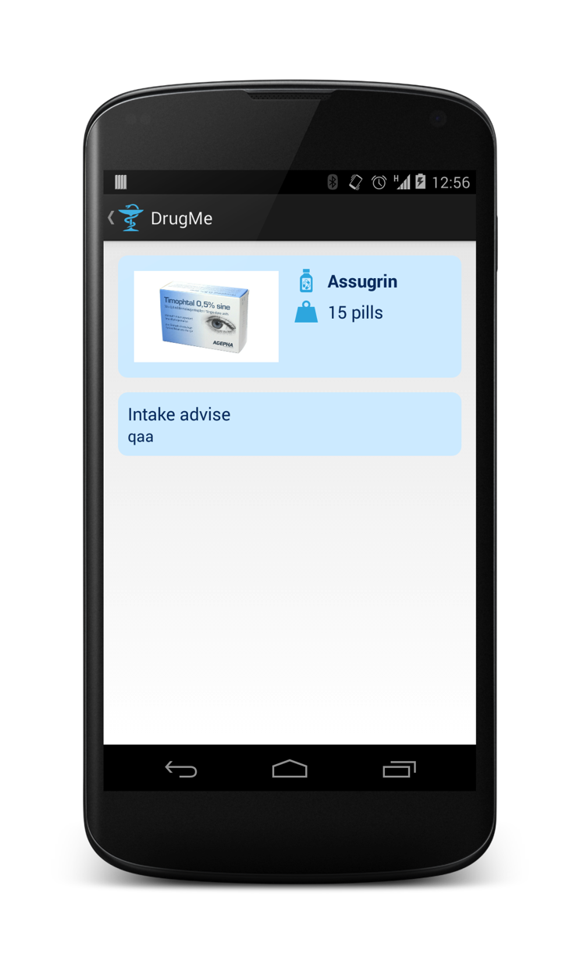
App – Medicin detail

Slide 13

App – Intake notification

Slide 14
App – Push notification

